Slide 1
Lesson 01.01 - Contracts and Functions
Aim: How do we compare functional and procedural languages?

Slide 2
Notes slide 1/4
Our class website is afsenyc.org/csprinciples
Check the calendar page for assignments

Slide 3
Notes slide 2/4 - Glossary
apply: use a given function on some inputs
arguments: the inputs to a function; expressions for arguments follow the name of a function
circle of evaluation: a diagram of the structure of an expression (arithmetic or code)
definitions window: the text box at the top of the Editor (DrRacket or WeScheme), where definitions for values and functions are written
editor: software in which you can write and evaluate code
evaluate: perform the computation in an expression, producing an answer
evaluates to: the result of computing an expression

Slide 4
Notes slide 3/4 - Glossary
expression: a computation written in the rules of some language (such as arithmetic, code, or a Circle of Evaluation)
function: a mathematical object that takes in some inputs and produces an output
interactions window: the text box at the top of the Editor (DrRacket or WeScheme), where we enter expressions to evaluate
legal expression: code that follows the Code Rules for a language
mathematical expression: a computation in arithmetic
programming language: a set of rules for writing code that a computer can evaluate

Slide 5
Notes slide 4/4
What is a program?
a program performs computations on data
Try to think of a program that doesn’t fit this definition.

Slide 6
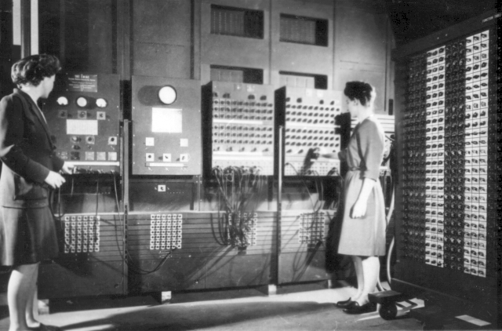
How do compilers and interpreters help develop programs?
A. They give the programmer access to specific functions designed for a specific purpose.
B. They make programs run faster.
C. They allow programmers to write programs without using machine code.

Slide 7
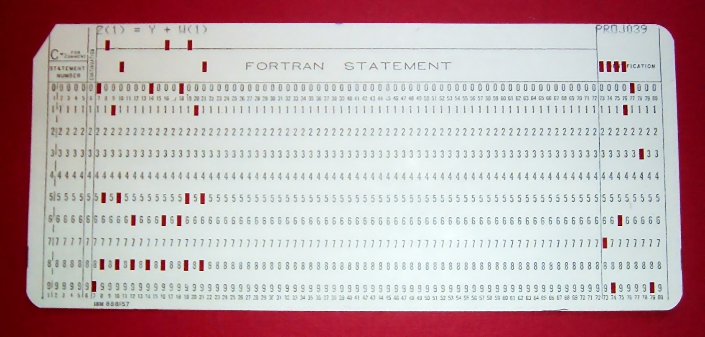
Fortran Punch Card

Slide 8
Functional vs. Procedural Languages
A. Procedurals languages mirror machine code
B. Functional programs allow you to program what you mean
C. Procedural languages are more common in the software engineering industry

Slide 9
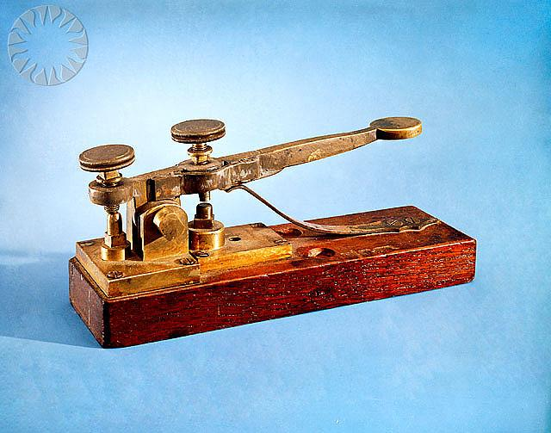
Leibniz's, Boole's, Turing's, Shannon's, & Morse's insight:
There are only 2 objects that a computer has to deal with in order to represent "anything."
What are they?

Slide 10
Böhm and Jacopini's insight:
3 actions needed to do anything
sequence:
first do this; then do that
selection:
IF such-&-such is the case,
THEN do this
ELSE do that
repetition:
WHILE such & such is the case DO this

Slide 11
Alan Turing's insight: 4 actions a computer must do
* move left one location
* move right one location
* read symbol at current location
* print 0 at current location
* print 1 at current location

Slide 12
Types | Functions

Slide 13
Types | Functions
Number | + - * / sqr sqrt expt

Slide 14
Here is the contract for a new function:
; +: Number Number -> Number
Here is the purpose statement for the function:
; + consumes two or more numbers and produces the sum of those numbers

Slide 15
Here is the contract for a new function:
; rectangle: Number Number String String -> Image
Here is the purpose statement for the function:
; consumes a width, height, mode, and ; color and produces an rectangle

Slide 16
Login
To wescheme.org click login and allow wescheme to access your google account.

Slide 17
Previous lesson slides

Slide 18
glossary
function: a mathematical object that takes in some inputs and produces an output
domain: the type of data that a function expects
range: the type of data that a function produces
contract: a statement of the name, domain, and range of a function
consume: to take in values to compute an expression
produce: to compute a value from an expression

Slide 19
glossary cont’
error message: information from the computer about errors in code
image: a type of data for pictures
identifier: how we refer to a function or value defined in a language (examples: +, *, star, circle)
string: any sequence of characters between quotation marks (examples: "hello", "42", "this is a string!")
type: refers to a general kind of data, like Number, String, Image, or Boolean
value: a specific piece of data, like 5 or "hello"

Slide 20
name: or the identifier, always comes right after the opening parenthesis
arguments: what the function needs to do its job
(circle 50 "solid" "red")
each function has an open and close parenthesis

Slide 21
Circles of Evaluation
Function Names: or identifiers, are like the verbs in a sentence, they are written above the line.
place-image
circle
square
25
100
50
"solid"
"red"
100
"solid"
"blue"
Arguments: like the object of a verb, arguments are given to functions to help functions do their work. They are written below the line.

